Slide 1



Portfolio Risk Management with Value at Risk (VaR)
Algorithms and Computer Theory - CS608
Team Members:( Group 4)
Battalapalli, Sai nadh
Chintamreddy, vishnuvarhan Reddy
Guntakindapalli, Gowthami
Yagavinti, Sai Dinesh

Slide 2
ABSTRACT
This project explores stock market data analysis using machine learning techniques to predict stock prices and assess portfolio risk. Utilizing a dataset of historical stock prices from S&P 500 companies, the study focuses on three major stocks: AAPL, GOOGL, and MSFT.
Data preprocessing steps, including filtering, feature engineering, and splitting, were applied to prepare the dataset for modeling.
Linear Regression, Logistic Regression, Decision Tree, and Random Forest were employed to enhance the depth of analysis. Metrics such as Mean Squared Error (MSE) and R² Score were used to evaluate model performance, with Linear Regression yielding promising results. Visualizations such as residual plots, scatter plots, and time-series comparisons were used to interpret the models’ accuracy and insights into stock price trends.
This study provides a comprehensive approach to leveraging machine learning for stock price prediction and risk assessment, contributing valuable tools for data-driven decision-making in financial analysis.

Slide 3

Introduction
What is Portfolio Risk Management?
The process of identifying, assessing, and mitigating the riskes associated with a portfolio of investments to minize potential losses and optimize returns.
Objectives: Calculating Value at Risk (VaR) and Conditional VaR (CVaR) for assessing portfolio risk
Overview of the project's significance in finance

Slide 4
Project Motivation
Importance of managing portfolio risk in volatile markets
Real-world application of VaR and CVaR for investors
Benefits of using quantitative risk management techniques

Slide 5
Dataset Overview
Data Source: S&P 500 historical stock prices from Kaggle (AAPL, MSFT, GOOGL)
Features included: Open, High, Low, Close, Volume
Brief summary of data characteristics: Dataset spans from 2013 to 2018, daily closing prices

Slide 6
Technologies Used:
Programming Language: Python
Libraries: Pandas, NumPy, scikit-learn, Matplotlib, Plotly, googleColab
Data preprocessing , analysis, visualization, and machine kearning model development

Slide 7
Data Preprocessing
Loaded and filtered dataset for selected stocks (AAPL, MSFT, GOOGL)
Handling missing values using forward-fill to ensure data continuity
Cleaned and prepared data for analysis: Removed null values, handled missing dates

Slide 8
Data Transformation
Calculated daily returns from adjusted close prices for risk calculations
Example: Daily returns calculated as “(current_price - previous_price) / previous_price”
Normalized data using StandardScaler for consistent analysis across assets
Importance of transforming data for better model accuracy: Standardized returns make comparison across assets easier

Slide 9
Literature Review
Introduction The study of financial markets has seen a significant transformation driven by advancements in theories, methodologies, and technological tools.
Relevant Studies :
Studies in stock market forecasting initially revolved around statistical techniques, such as Fama’s (1970) Efficient Market Hypothesis (EMH), which argued that market prices fully reflect all available information, limiting prediction accuracy.
Findings:
In the 1990s, Value at Risk (VaR), introduced by Philippe Jorion, became a standard tool to measure potential losses in portfolios, though its limitations in extreme conditions led to the development of Conditional Value at Risk (CVaR). Additionally, GARCH models have been widely used for forecasting volatility, aiding in better risk predictions.
Applications:
These findings have transformed financial practices. Machine learning powers algorithmic trading, enabling rapid, data-driven decision-making. Robo-advisors apply portfolio optimization principles to deliver personalized investment strategies

Slide 10
Methodologies
Data Cleaning: Involves handling missing values, removing duplicates, and encoding categorical variables to ensure the dataset is accurate and ready for analysis.
Descriptive Analysis: Uses statistical measures like mean, median, and standard deviation to summarize key features of the dataset, revealing trends and relationships.
Visualization: Visual tools like histograms, bar plots, and scatter plots are used to display data insights, making patterns and trends easy to understand.
Tools Used:
Pandas for data manipulation and cleaning.
NumPy for numerical operations.
Matplotlib & Seaborn for static visualizations.
Plotly for interactive charts.
Google Colab for interactive coding and analysis.

Slide 11
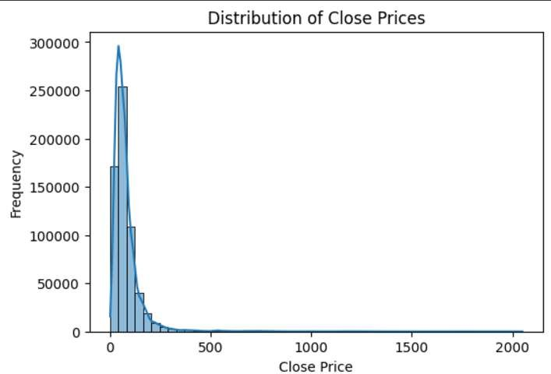
Exploratory Data Analysis (EDA): (Visualizations)
Results:
Exploratory Data Analysis (EDA): (Visualizations)
Distribution of close prices:
Most of the stocks have close prices clustered at lower ranges, suggesting the majority are valued similarly.
The presence of significant outliers with high prices may indicate premium or high- performing stocks.
This distribution helps identify typical price ranges for most stocks and potential high-value opportunities.

Slide 12
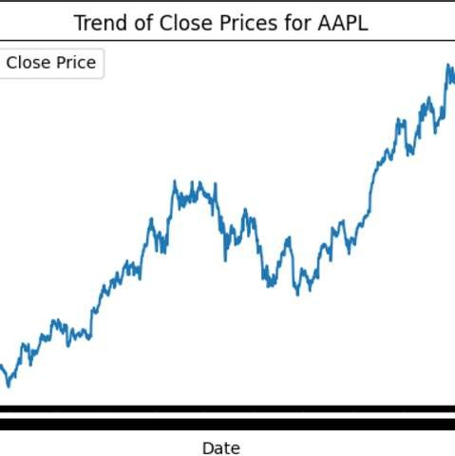
TREND OF CLOSE PRICES FOR AAPL
The graph shows AAPL’s price trend over time, indicating strong upward growth, especially in recent years.
Notable dips, such as those during specific market downturns, reflect investor responses to broader market conditions or company-specific events.
This information is crucial for understanding the risk-return profile of AAPL and the impact of market sentiment on the stock

Slide 13
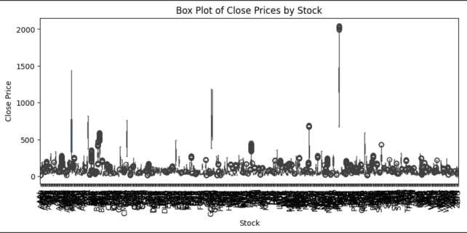
BOX PLOT OF CLOSE PRICES BY STOCK
The box plot highlights the range of stock prices
across different companies.
Stocks with large spreads in the box plot indicate greater volatility, which could imply higher risk.
The outliers visible in the plot represent significant deviations from the typical price range, which could signal exceptional circumstances or extreme value shifts

Slide 14
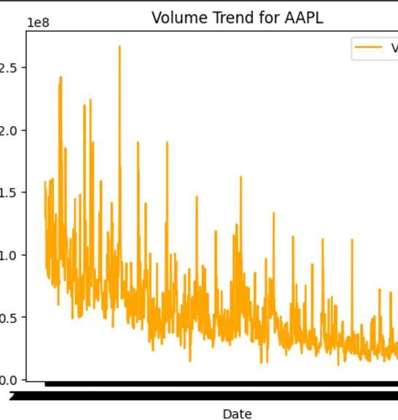
VOLUME TREND FOR AAPL:
The volume trend for AAPL shows a gradual decrease over time, indicating reduced trading activity.
Peaks in the volume graph correlate with significant market events, possibly indicating increased investor activity during announcements.
Understanding trading volume helps gauge investor interest and identify periods of potential price change

Slide 15
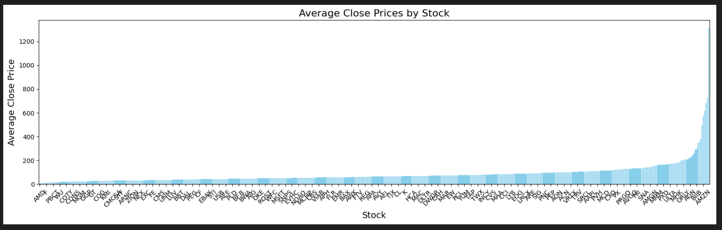
AVERAGE CLOSE PRICES BY STOCK
The bar chart shows a significant disparity in average close prices between different companies.
Stocks with higher average close prices may be perceived as more stable or premium investments compared to those with lower averages.
These insights help identify which stocks might be more resilient during market fluctuations based on their average valuation.

Slide 16
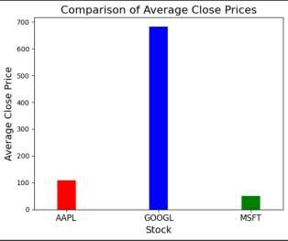
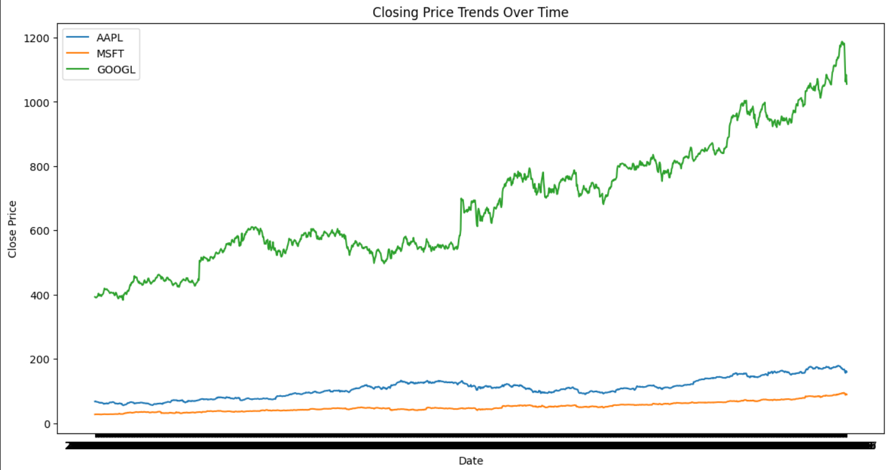
COMPARAIVE ANALYSIS OF AAPL, MSFT, AND GOOGL
Comparison of historical close prices of AAPL, MSFT, and GOOGL to highlight similarities and differences.
The comparison graph showcases how the market trends of these three companies evolve over time.
AAPL, MSFT, and GOOGL all show a positive growth trend, suggesting strong market performance
Differences in volatility highlight which company is more susceptible to market events.
Such a comparison is critical for diversification strategies, helping investors decide how to allocate assets.

Slide 17
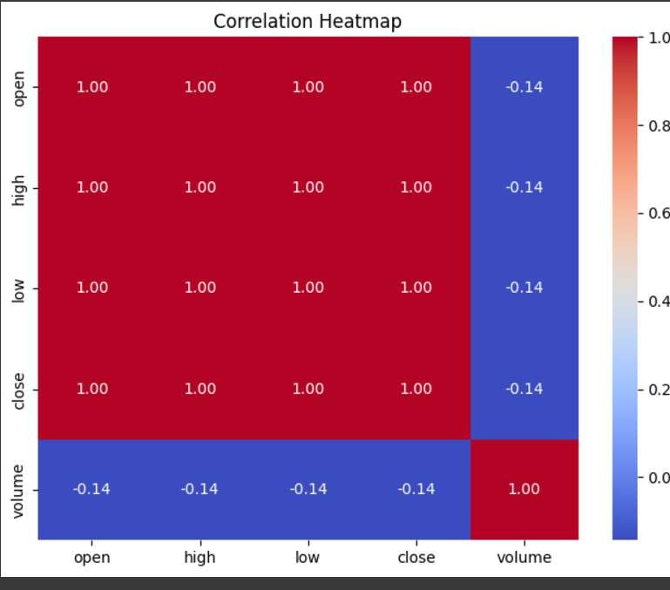
Correlation Analysis:
Correlation Heatmap:
The strong positive correlation between 'open', 'high', 'low', and 'close' indicates that these metrics typically move together, suggesting consistency in price movement.
The negative or low correlation between 'volume' and price metrics implies that trading volume does not significantly drive price movement for these stocks.
This insight helps in understanding which metrics are closely related and can be useful for predicting future trends.

Slide 18
MACHINE LEARNING IMPLEMENTATION

Slide 19
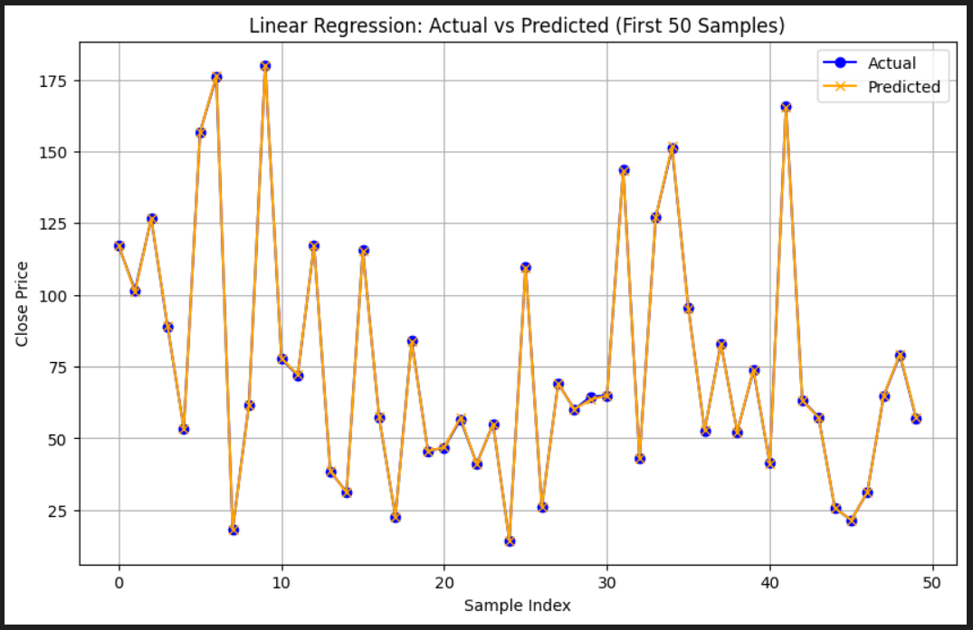
LINEAR REGRESSION:
Linear Regression identifies the relationship between stock prices (close) and features like open, high, and volume, offering a straightforward approach to modeling trends in stock prices. It effectively captures linear dependencies in historical data, providing reliable short-term predictions.
Implication:
These predictions enable investors and analysts to make informed decisions about stock performance and guide strategic resource allocation in trading.
The graph compares actual and predicted close prices using a linear regression model, showing that the predictions capture general trends but fail to replicate the high volatility and sharp fluctuations of the actual data. This indicates that linear regression struggles to model extreme variations in the dataset effectively.
Performance Metrics:
Mean Squared Error (MSE): (0.47)
The average squared difference between actual and predicted values.
Lower values indicate better model performance.
R-squared (R²): (1.00)
The model explains 100% of the variance in the target variable.
A perfect fit indicates excellent prediction accuracy.

Slide 20
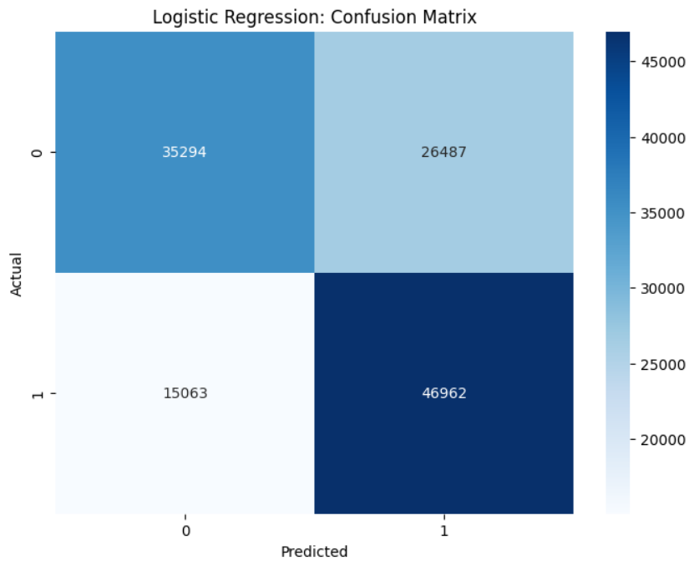
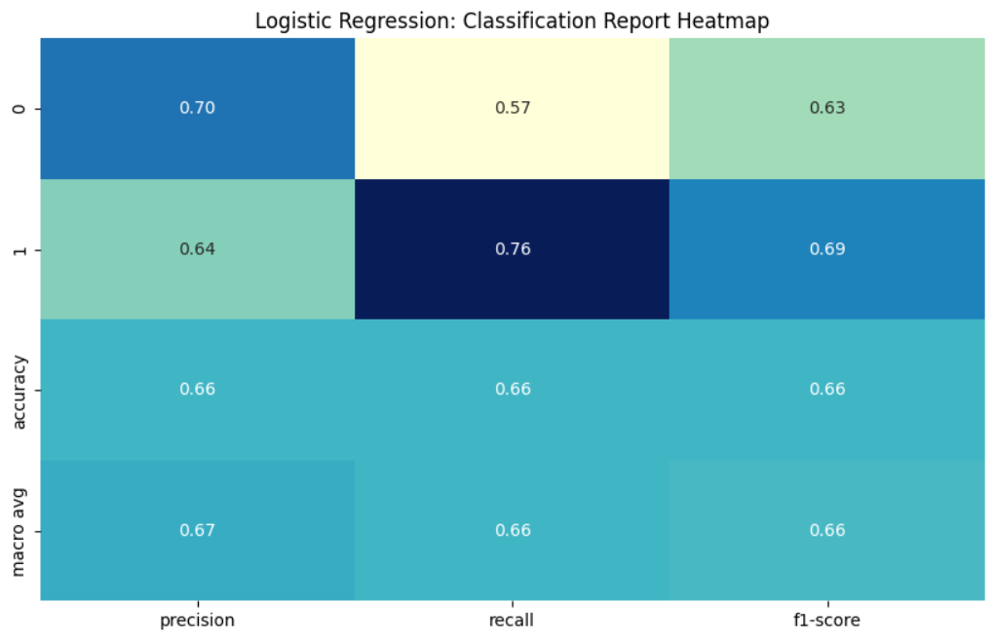
2. LOGISTIC REGRESSION:
Logistic Regression classifies stock price movements (e.g., increase or decrease) by analyzing patterns in features such as daily price range and volume. It performs well in binary classification tasks when data is well-balanced and preprocessed.
Implication: The model aids in risk assessment by identifying probable upward or downward trends, supporting portfolio managers in minimizing potential losses.
Performance Metrics:
The Logistic Regression model achieved an accuracy of 66%, with class 1 having better recall (76%) but lower precision (64%), while class 0 had higher precision (70%) but lower recall (57%), indicating a moderate performance with room for improvement, particularly in class 0.

Slide 21
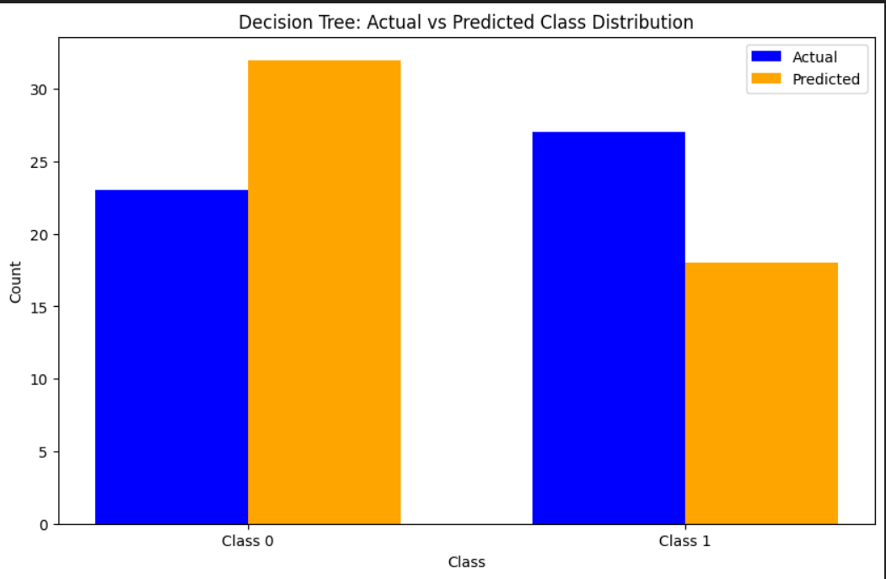
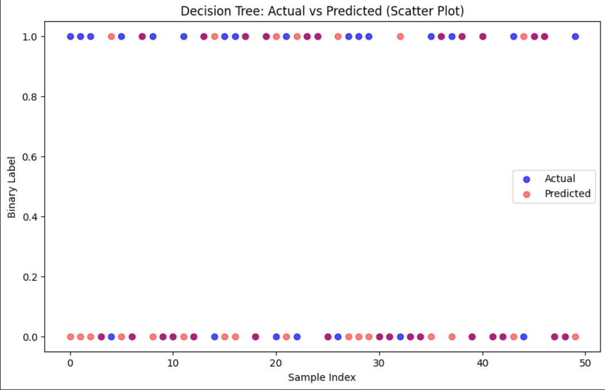
3. DECISION TREE:
Decision Trees effectively interpret non-linear relationships in stock price trends by segmenting the data based on key features like trading volume and low prices. This model identifies the specific conditions under which stock prices exhibit predictable behavior, making it highly effective for understanding price patterns.
Implication: The model’s ability to generate clear decision rules allows stakeholders to develop rule-based strategies for stock trading, simplifying complex stock behaviors and enabling more informed tactical investment decisions.
Performance Metrics:
The Decision Tree model achieved an accuracy of 66%, with class 0 having better recall (71%) but lower precision (64%), and class 1 having higher precision (68%) but lower recall (60%), indicating a balanced but moderate performance.

Slide 22
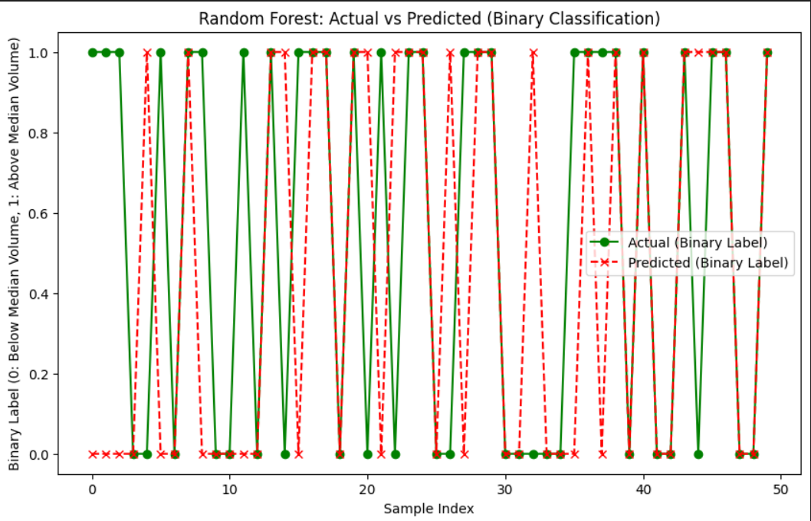
RANDOM FOREST:
Random Forests aggregate predictions from multiple Decision Trees, capturing intricate patterns in stock price movements and minimizing overfitting. By handling large datasets effectively, this model provides more accurate and robust forecasts for stock trends.
Implication: The ensemble nature of Random Forests enhances prediction accuracy, empowering traders with reliable data-driven strategies for portfolio optimization and helping to mitigate risks associated with stock market volatility.
Performance Metrics:
The Random Forest model achieved an accuracy of 66%, with class 0 having better recall (71%) but lower precision (65%), and class 1 having higher precision (68%) but lower recall (62%), indicating a balanced yet moderate performance.

Slide 23
Conclusion and Next Steps:
Summary of Findings: Risk assessment varies significantly across assets; MSFT shows lower risk, GOOGL shows higher potential for gains but with increased risk

Slide 24
RECOMMENDATIONS:

Slide 25
REFERENCES

Slide 26
GITHUB REPOSITORY FOR CODE

Slide 27

Thank you

